Slide 1
Chapter 4 Linear Models for Classification

Slide 2
Contents
4.1 Discriminant Functions
4.2 Probabilistic Generative Models
4.3 Probabilistic Discriminative Models
4.4 The Laplace Approximation
4.5 Bayesian Logistic Regression

Slide 3
















4.1 Discriminant Functions
Two classes
Decision boundary:
Multiple classes
one-versus-the-rest classifier: $K−1$classifiers
one-versus-one classifier: $K(K − 1)/2$binary discriminant functions
single $K$-class discriminant:
$$x∈C_{k}$$
Least squares for classification
Each class
$$\tilde{W}=\left({\tilde{w}}_{1},…,{\tilde{w}}_{K}\right)$$
Training data
Sum-of-squares error function
A new input $x∈C_{k},$ if
is largest.
Notes:
A discriminant is a function that takes an input vector x and assigns it to one class.

Slide 4
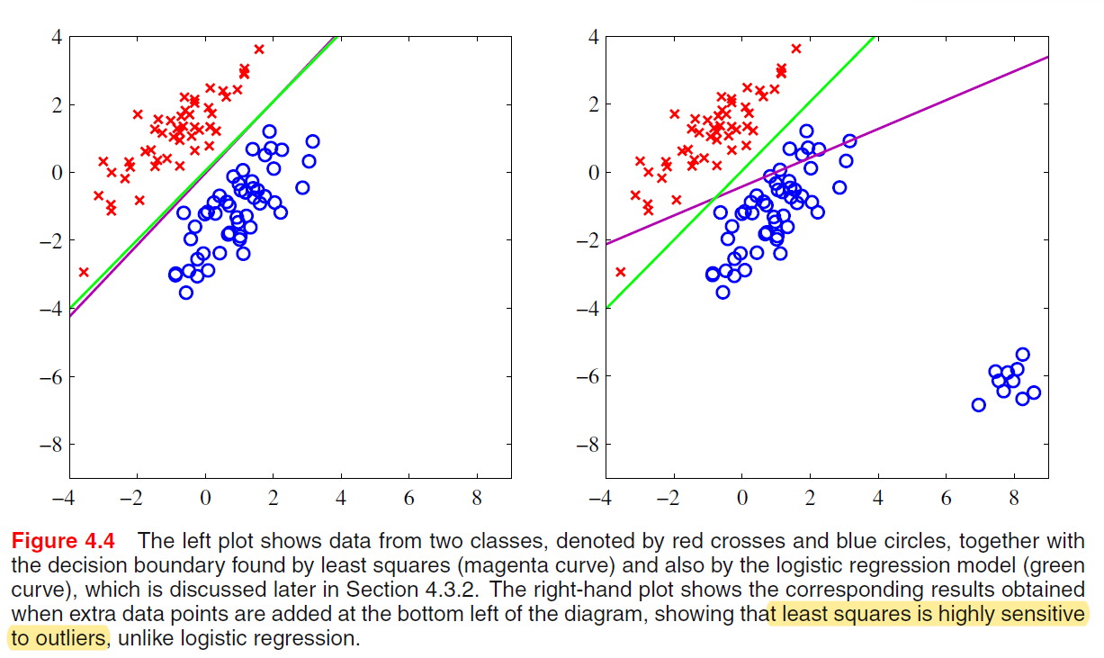
4.1 Discriminant Functions
Least squares for classification

Slide 5











4.1 Discriminant Functions
Fisher’s linear discriminant
select a projection that maximizes the class separation
maximize
have considerable overlap
Fisher’s idea maximizes a function that will give a large separation between the projected class meanwhile
also giving a small variance within each class, thereby minimizing the class overlap.
class $C_{k}$’s within-class variance
The Fisher criterion
Fisher’s linear discriminant
between-class covariance matrix:
total within-class covariance matrix

Slide 6
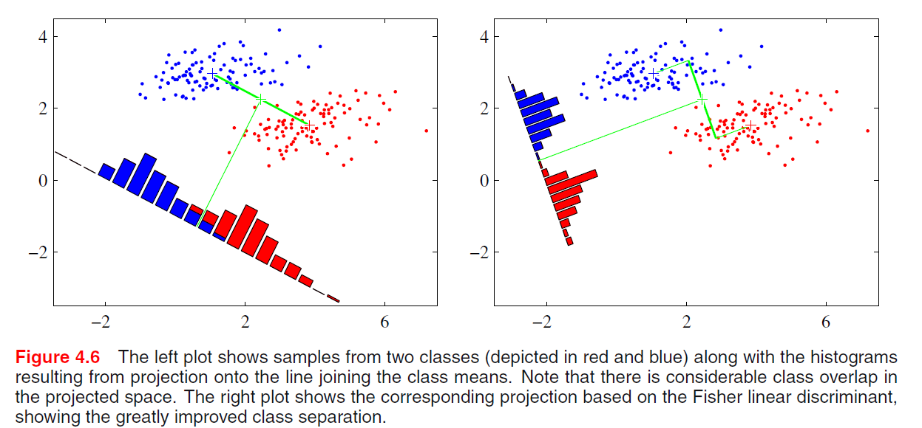
4.1 Discriminant Functions
Fisher’s linear discriminant

Slide 7





4.1 Discriminant Functions
The perceptron algorithm
Perceptron function
nonlinear activation function
Target values
perceptron criterion
denotes the set of all misclassified patterns
Stochastic gradient descent
Perceptron convergence theorem: if there exists an exact solution (in other words, if the training data set is linearly separable), then the perceptron learning algorithm is guaranteed to find an exact solution in a finite number of steps.
Notes:
Another example of a linear discriminant model

Slide 8
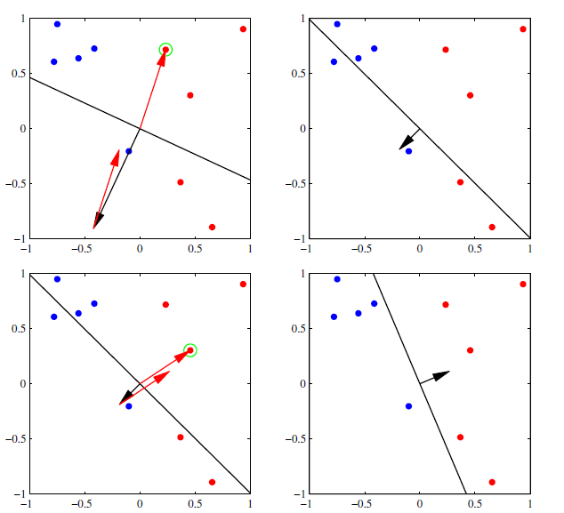
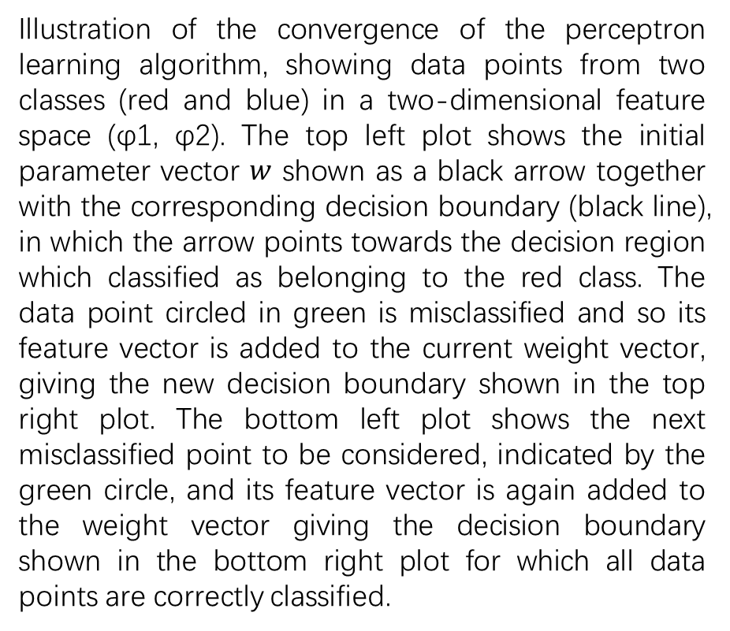
4.1 Discriminant Functions
The perceptron algorithm
Illustration of the convergence of the perceptron learning algorithm, showing data points from two classes (red and blue) in a two-dimensional feature space (φ1, φ2). The top left plot shows the initial parameter vector $w$ shown as a black arrow together with the corresponding decision boundary (black line), in which the arrow points towards the decision region which classified as belonging to the red class. The data point circled in green is misclassified and so its feature vector is added to the current weight vector, giving the new decision boundary shown in the top right plot. The bottom left plot shows the next misclassified point to be considered, indicated by the green circle, and its feature vector is again added to the weight vector giving the decision boundary shown in the bottom right plot for which all data points are correctly classified.

Slide 9




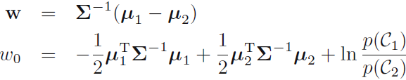
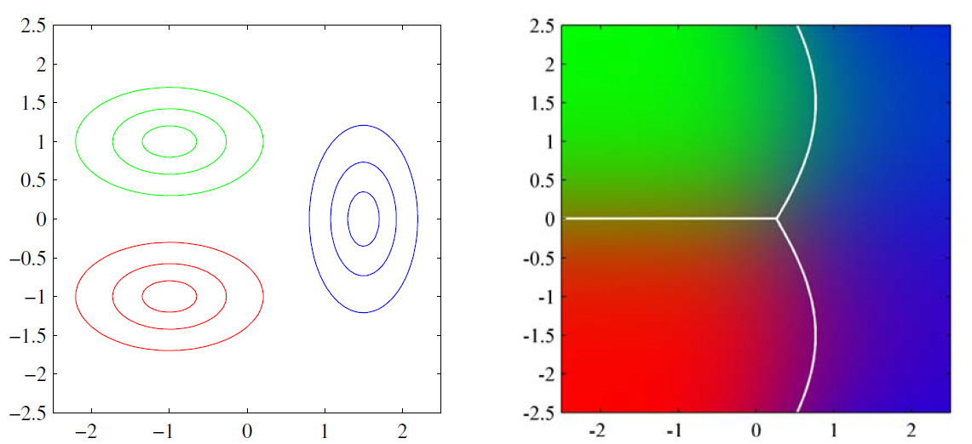
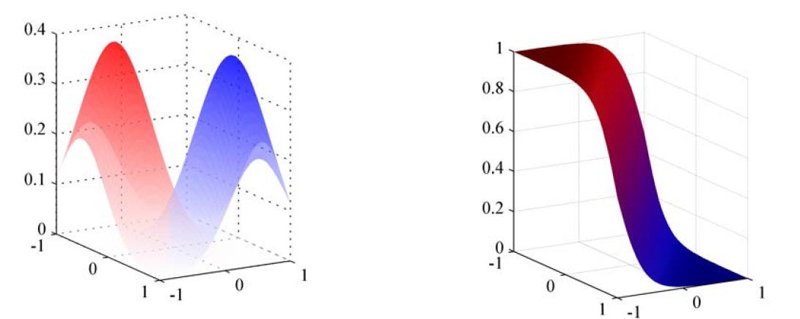
4.2 Probabilistic Generative Models
Continuous inputs
Assume that the class-conditional densities are Gaussian and all classes share the same covariance matrix.
Two classes case
Posterior
logistic sigmoid
class-conditional densities
Posterior
Posterior
class-conditional densities

Slide 10




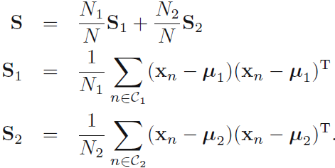
4.2 Probabilistic Generative Models
Maximum likelihood solution
Once we have specified a parametric functional form for the class-conditional densities $p(x|C_{k})$, we can then determine the values of the parameters, together with the prior class probabilities $p(C_{k})$, using maximum likelihood.
likelihood function

Slide 11
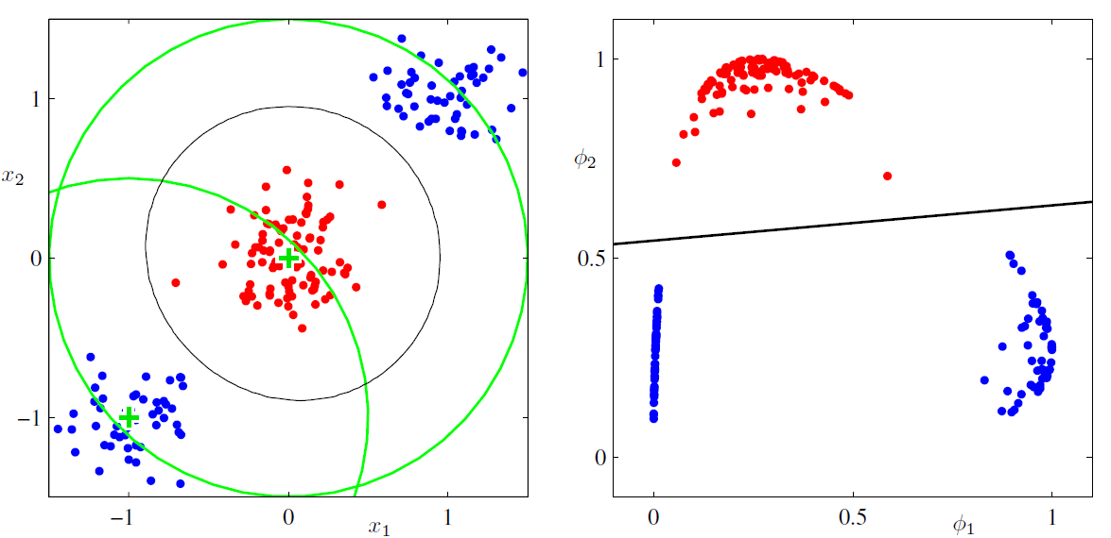
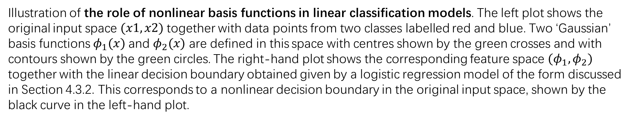
4.3 Probabilistic Discriminative Models
Illustration of the role of nonlinear basis functions in linear classification models. The left plot shows the original input space $(x1, x2)$together with data points from two classes labelled red and blue. Two ‘Gaussian’ basis functions $φ_{1}(x)$and $φ_{2}(x)$ are defined in this space with centres shown by the green crosses and with contours shown by the green circles. The right-hand plot shows the corresponding feature space ${(φ}_{1},φ_{2})$ together with the linear decision boundary obtained given by a logistic regression model of the form discussed in Section 4.3.2. This corresponds to a nonlinear decision boundary in the original input space, shown by the black curve in the left-hand plot.

Slide 12











4.3 Probabilistic Discriminative Models
Logistic regression
posterior
is the logistic sigmoid function
feature vector
For an $M$-dimensional feature space $φ$, this model has $M$ adjustable parameters.
likelihood
Cross entropy error
Notes:
an alternative approach is to use the functional form of the generalized linear model explicitly and to determine its parameters directly by using maximum likelihood.
One advantage of the discriminative approach is that there will typically be fewer adaptive parameters to be determined,

Slide 13

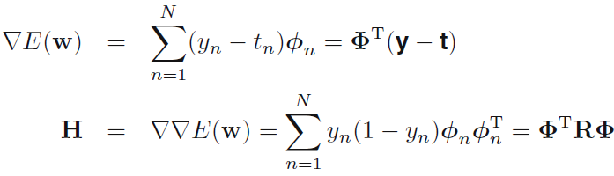

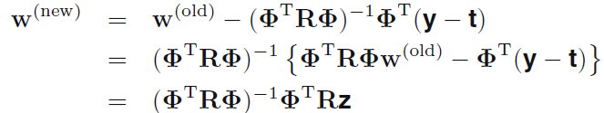

4.3 Probabilistic Discriminative Models
Iterative reweighted least squares
The error function is convex, can be minimized by an efficient iterative technique based on the Newton-Raphson iterative optimization scheme.
where

Slide 14










4.4 The Laplace Approximation
To find a Gaussian approximation $q(z)$ which is centred on a mode of the distribution $p(z)$.
1. first step is to find a mode of $p(z)$
2. Taylor expansion of ln $f(z)$
where
3.
4. Normalize
stationary point $z_{0}$ must be a local maximum
Notes:
Before discussing the Bayesian treatment of logistic regression, it is necessary to introduce a form of approximation. Because that is more complex than the Bayesian treatment of linear regression models.

Slide 15
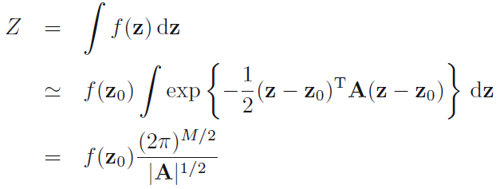

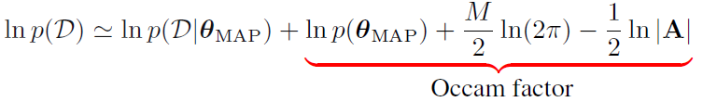

4.4 The Laplace Approximation
Model comparison and BIC
Normalization constant
approximation to the model evidence
penalizes model complexity
If the Gaussian prior distribution over parameters is broad, and the Hessian has full rank
Bayesian Information Criterion

Slide 16


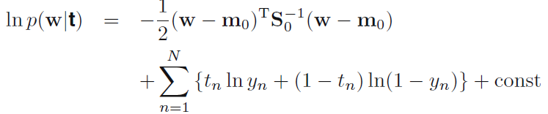




4.5 Bayesian Logistic Regression
Exact Bayesian inference for logistic regression is intractable.
Use Laplace approximation
Gaussian prior
Posterior distribution
Maximum posterior
$$S_{N}^{−1}=$$
Gaussian approximation to the posterior distribution
Notes:
We now turn to a Bayesian treatment of logistic regression. Exact Bayesian inference for logistic regression is intractable.

Slide 17







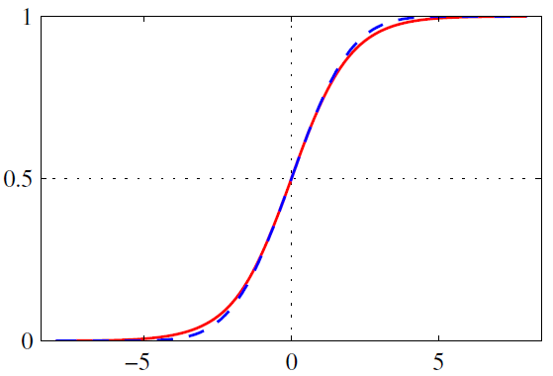
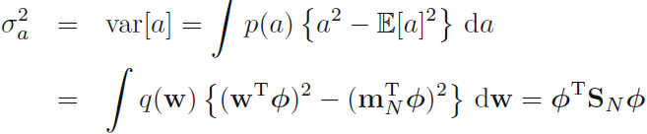






4.5 Bayesian Logistic Regression
Use a Gaussian distribution
to approximate the posterior
Predictive distribution
where $δ(·)$is the Dirac delta function
where
sigmoid
probit
variational approximation to the predictive distribution
Use probit function to approximate logistic sigmoid function

